Slide 1

How To Display “Real” Numbers

Slide 2
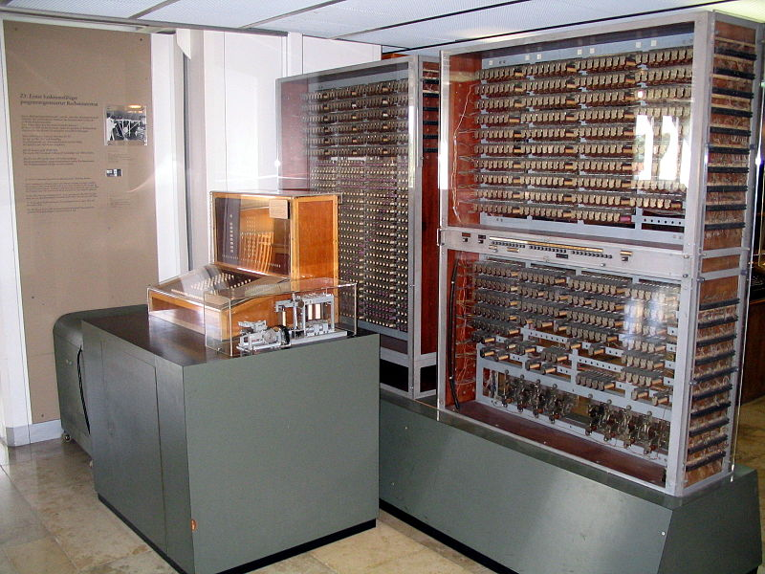
Floating Point

Slide 3
Code Examples
0. open IRB
1. type money = 15
2. type money / 2
3. observe the wrong answer
4. type money.to_f / 2.0 and see why floating point matters
5. type (2.0-1.1)==0.9

